Slide 1
Debugging JAX & Flax NNX:
A Guide for PyTorch Users
Leveraging Familiar Concepts and Mastering New Tools
Notes:
If you're coming from PyTorch, you know that debugging is crucial. JAX and Flax NNX offer amazing performance and a clean API, but debugging can feel different due to JAX's compilation model. Today, we'll bridge the gap, exploring how to debug JAX and NNX effectively, relating techniques back to your PyTorch experience. We'll focus specifically on the Flax NNX API.

Slide 2
Why is JAX Debugging Different? The JIT Impact
PyTorch: Mostly eager execution. print(),pdb work directly on runtime values.
JAX: Relies heavily on Just-In-Time (JIT) compilation (@jax.jit) for performance.
Tracing Phase: Python code runs once with abstract tracers (shapes/types) to build a computation graph. Standard print() or pdb only see these tracers. However tracers can be useful, since they carry shapes and dtypes.
Execution Phase: Compiled graph (e.g., XLA) runs later on CPU/GPU/TPU with concrete values. Standard tools can't inspect this directly.
Challenge: How to inspect runtime values inside JIT-compiled code?
Notes:
The biggest shift from PyTorch is JAX's JIT compilation. When you @jax.jit() a function, the Python code you wrote doesn't run line-by-line with your actual data during computation. It runs once during a 'tracing' phase using placeholders. The real computation happens later in optimized code. This means your standard Python print() or pdb placed inside a JITted function won't show you the runtime numbers you expect; they'll show you information about the tracing process itself (which can also be useful, since they carry shapes and dtypes, but usually you’re interested in runtime values). This divergence requires JAX-specific debugging tools.

Slide 3
"printf Debugging" in JAX: jax.debug.print()
The JAX equivalent of print() for use inside transformed functions (jit, vmap, grad).
Embeds the print operation into the compiled computation graph.
Outputs concrete runtime values during execution.
Use ordered=True to ensure prints appear sequentially as written.
Notes:
So, how do you print runtime values? Use jax.debug.print(). Think of it as the JAX-aware version of Python's print(). It gets compiled into the execution graph, and prints the actual runtime values as they are computed.

Slide 4
"printf Debugging" in JAX: jax.debug.print()
@jax.jit
def compute_intermediate(x):
y = x * 2
print("Standard print (tracer):", y) # Sees tracers during compilation
# Sees runtime values
jax.debug.print("jax.debug.print (runtime value): {y}", y=y, ordered=True)
z = y + 1
return z
compute_intermediate(jnp.array(5.0))
# Output:
# Standard print (tracer): Traced<ShapedArray(float32)...>
# jax.debug.print (runtime value): 10.0
Notes:
Notice in the example, the standard print() shows a tracer object, while jax.debug.print() shows the runtime value '10.0'. Remember to include the ordered=True argument if you have multiple prints and need them in source order, as the compiler might reorder operations.

Slide 5
Interactive Debugging in JIT: jax.debug.breakpoint()
The JAX equivalent of pdb.set_trace() or breakpoint() for use inside transformed functions.
Pauses execution at runtime within the compiled code.
Provides a (jaxdb) prompt similar to pdb.
Allows inspecting runtime values of variables in the JAX context (p variable_name).
Use c to continue, q to quit.
Can be made conditional using jax.lax.cond().
Notes:
For interactive debugging within JIT, use jax.debug.breakpoint(). This is JAX's version of pdb. When the compiled code hits this breakpoint, execution pauses, and you get a jaxdb prompt right in your terminal. You can then inspect the runtime values of available variables using commands like p y. This is incredibly useful for digging into complex computations without having to exit the JIT context. You can even combine it with JAX control flow like jax.lax.cond() to break only when certain conditions are met. By the way, you can also just use a normal Python breakpoint if you want to look at the tracers.

Slide 6
Interactive Debugging in JIT: jax.debug.breakpoint()
@jax.jit
def check_value(x):
y = jnp.sin(x)
jax.debug.print("Value before breakpoint: {y}", y=y)
jax.debug.breakpoint() # Execution pauses here
z = jnp.cos(y)
return z
check_value(jnp.array(0.5))
# Output: Value before breakpoint: 0.47942555
# (jaxdb) p y
# Array(0.47942555, dtype=float32)
# (jaxdb) c
Notes:
Here’s a basic example. We should note however that the jaxdb commands are a subset of the pdb commands. For example, you cannot step.

Slide 7
Visualizing Data Layout: jax.debug.visualize_array_sharding
Problem: Need to verify data layout across devices in distributed settings with sharding.
Tool: jax.debug.visualize_array_sharding(array) prints text diagram of layout.
How it Works: Shows which data slice is on which device ID at runtime.
Usage: Call inside JIT/distributed functions to check sharding from Mesh/PartitionSpec.
Notes:
When using multiple devices, understanding how JAX splits (or 'shards') your arrays is vital. jax.debug.visualize_array_sharding helps here. Call it inside your distributed function with a sharded array. It prints a text diagram at runtime showing exactly which part of the array is on which device, confirming your partitioning strategy.

Slide 8
visualize_array_sharding Code Example
# --- Assume mesh setup (e.g., 2x2) ---
# mesh = Mesh(devices, ('data', 'model'))
# P = PartitionSpec
@jax.jit
def my_distributed_func(x_sharded):
# Visualize input array layout
print("--- Input Sharding ---")
jax.debug.visualize_array_sharding(x_sharded) # <<< Visualize
y = x_sharded * 2 # Computation
print("--- Output Sharding ---")
jax.debug.visualize_array_sharding(y) # <<< Visualize
return y
Notes:
Assuming you have a device mesh and a sharded input array name x_sharded, calling visualize_array_sharding inside your JITted function will print diagrams for both the input and output arrays, showing how they are distributed across the conceptual device grid defined by your mesh.

Slide 9
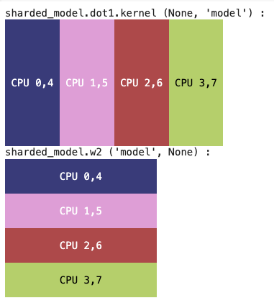
Visualizing Data Layout: jax.debug.visualize_array_sharding
Notes:
For example, here’s the display in a notebook for a 4x2 sharding.

Slide 10
Back to Basics: Temporarily Disabling JIT
Sometimes you just want standard Python debugging.
jax.disable_jit() forces JAX functions to execute eagerly (like PyTorch/NumPy).
Allows standard print() and pdb/breakpoint() to work as expected, inspecting runtime values directly.
Also enables IDE debuggers like VS Code
Notes:
What if the JAX tools aren't enough, or you just want the familiarity of pdb? JAX provides an 'escape hatch': jax.disable_jit(). This tells JAX to run the code eagerly, like PyTorch. Inside a disable_jit block, your regular print statements and pdb.set_trace() calls will work exactly as you expect, and it even enables you to use IDE debuggers like the VS Code debugger.

Slide 11
Back to Basics: Temporarily Disabling JIT
How to use:
Context Manager: with jax.disable_jit(): ... (Recommended for locality)
Globally: jax.config.update("jax_disable_jit", True)
Environment Var: JAX_DISABLE_JIT=1
Major Drawback: Disables JIT optimizations -> significantly slower execution. Use temporarily for debugging!
Notes:
You can disable jit() in three ways, using either a context manager, or globally, or with an environment variable. But be warned: this turns off JIT optimizations, so your code will run much slower. It's a powerful debugging tool, but use it temporarily and remember to remove it for performance.

Slide 12
Back to Basics: Temporarily Disabling JIT
@jax.jit
def problematic_function(x):
y = jnp.log(x)
# pdb works here ONLY if JIT is disabled
pdb.set_trace()
return y * 2
# Execute with JIT disabled for this block
with jax.disable_jit():
print("Running with JIT disabled...")
result_no_jit = problematic_function(jnp.array(5.0)) # pdb triggers
Notes:
This code example shows how pdb becomes effective within the with block.

Slide 13
Back to Basics: Temporarily Disabling JIT
Limits on jax.disable_jit():
If you’re using functional transforms, like jax.vmap and jax.scan, you won't be able to break into the function to inspect values
But tools like sow from NNX are designed to be compatible with these transforms
Notes:
There are some limits on how deep you can go into transformed functions, even with jax.disable_jit(). If you’re using transformations like jax.vmap or jax.scan you won’t be able to go all the way into the vectorized or scanned executions. However, you can still use tools like NNX’s sow to capture intermediates for example.

Slide 14
Automatic NaN Hunting: The jax_debug_nans Flag
Problem: Numerical instability leading to NaNs inside JITted code can be hard to trace.
Solution: Enable the jax_debug_nans configuration flag.
jax.config.update("jax_debug_nans", True) (in Python)
Environment Variable: JAX_DEBUG_NANS=1
Notes:
Tracking down the source of 'Not a Number' or NaN values inside complex, JIT-compiled functions is a common headache. JAX offers a helpful flag called jax_debug_nans. You can enable it via jax.config.update or an environment variable.

Slide 15
Automatic NaN Hunting: The jax_debug_nans Flag
How it Works:
Monitors JIT computations for NaN outputs.
If a NaN is detected, JAX automatically re-runs the function in eager mode (like disable_jit) to pinpoint the exact operation causing the NaN and raise an error there.
Notes:
When jax_debug_nans is active, JAX watches the outputs of operations inside JIT. If it spots a NaN, it automatically re-runs that part of the code eagerly – step-by-step – until it finds the exact primitive operation that produced the NaN, and then it raises an error pointing right at it. This saves a lot of manual searching.

Slide 16
Automatic NaN Hunting: The jax_debug_nans Flag
Limitations:
Can significantly slow down execution due to checks and potential eager re-runs.
Might raise errors on intentionally created NaNs.
Best used during debugging, disable for production/performance runs.
Notes:
However, be aware it adds overhead, so it slows things down. Use it when you suspect NaNs, then turn it off.

Slide 17
Inspecting Flax NNX Models: nnx.display()

Slide 18
Understanding Your NNX Model: nnx.display()
Flax NNX is designed with inspectability in mind (uses standard Python objects)
nnx.display() provides a clear view of NNX objects:
nnx.Module (models, layers)
nnx.Optimizer
nnx.State
Other contained JAX arrays/objects
Notes:
Flax NNX aims to make models easier to understand. The key tool here is nnx.display(). Use it on your NNX models, layers, or optimizers. It gives you a snapshot of the object's structure, including parameters and any state variables, showing their names, types, shapes, and current values.

Slide 19
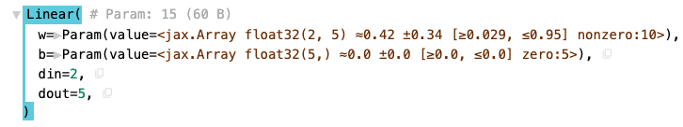
Understanding Your NNX Model: nnx.display()
Shows structure, parameters, state variables, shapes, types, and values.
Creates a rich, interactive tree view in notebooks/Colab. Falls back to standard print otherwise.
Analogous to print(pytorch_model) but often more detailed and interactive.
Notes:
If you're in a notebook, you get a nice interactive tree. This is great for verifying your model architecture or inspecting optimizer state. And since NNX modules are now native JAX Pytrees, nnx.display is essentially giving you a rich, explorable view of that Pytree structure. It’s not just a printout; it’s a view into the fundamental data structure that JAX transformations operate on.

Slide 20
Capturing Intermediate Values: nnx.sow()

Slide 21
Flax NNX Module.sow() - Capturing Intermediate Values
What is Module.sow()?
A method within flax.nnx.Module designed to capture and store intermediate values computed during a module's forward pass.
Purpose: Simplifies tracking internal computations (e.g., activations, gradients) without manually passing data structures through the call stack.
Useful for:
Debugging model behavior.
Visualizing intermediate layer outputs.
Implementing custom loss functions based on internal states.
Notes:
Let’s look at another useful feature within Flax's NNX module system: Module.sow().
So, what exactly is Module.sow()? At its core, it's a method built into flax.nnx.Module specifically designed to let you capture and store intermediate values that get computed while your model is running its forward pass. Think of things like the outputs of specific layers or other internal calculations.
Why is this useful? Well, it significantly simplifies the process of tracking these internal computations. Instead of manually creating and passing dictionaries or other data structures through your entire model's call stack just to grab a value somewhere in the middle, sow provides a direct way to 'plant' or 'sow' that value right where it's generated.
This makes it incredibly handy for several tasks: debugging your model's behavior by inspecting internal states, visualizing the outputs of intermediate layers to understand what the model is learning, or even implementing more complex, custom loss functions that rely on these internal activation values.

Slide 22
Flax NNX Module.sow() - Capturing Intermediate Values
How it Works: Core Arguments
self.sow(variable_type, name, value, *, reduce_fn=None, init_fn=None)
variable_type: Specifies the variable wrapper (e.g., nnx.Intermediate). Used for later filtering/retrieval.
name (str): The attribute name under which the value will be stored on the module instance.
value: The actual JAX array or Python object to be stored.
(Optional) reduce_fn, init_fn: Customize how values are stored/aggregated if sow is called multiple times with the same name
Notes:
Now let's look at how you actually use it. The basic signature involves a few key arguments. First, variable_type: this tells sow how to categorize the value you're saving, often using something like nnx.Intermediate. This typing helps later when you want to filter or retrieve specific kinds of saved values. Second, name: this is simply a string that defines the attribute name under which the value will be stored directly on your module instance. Third, value: this is the actual data that you want to save – typically a JAX array, but it can be other Python objects too.
There are also optional arguments, reduce_fn and init_fn, which allow for more customized behavior when you call sow multiple times for the same named value.

Slide 23
Using Module.sow() - Storage, Retrieval & Customization
class SimpleModel(nnx.Module):
def __init__(self, rngs):
self.dense = nnx.Linear(2, 3, rngs=rngs)
def __call__(self, x):
x = self.dense(x)
# Sow the output of the dense layer
self.sow(nnx.Intermediate, 'dense_output', x)
return x * 2
model = SimpleModel(rngs=nnx.Rngs(0))
y = model(jnp.ones((1, 2)))
# Retrieve the sown value
intermediate_val = model.dense_output.value
# Output: (array([[...]]),) - A tuple containing the value
print(intermediate_val)
Notes:
Alright, let's see sow in action with a simple example. Here we have a basic SimpleModel with a single dense layer. Inside the __call__ method, after applying the dense layer, we use self.sow(). We specify nnx.Intermediate as the type, give it the name 'dense_output', and pass the layer's output x as the value.
After we instantiate the model and run it with some input, how do we get that value back? As mentioned, sow stores the value as an attribute on the module instance itself, using the name we provided. So, we can access it directly via model.dense_output. Importantly, the actual data is held within the .value property of this attribute. So, model.dense_output.value gives us the stored intermediate value.

Slide 24
Flax NNX Module.sow() - Capturing Intermediate Values
Storage and Retrieval
Sown values are stored as attributes on the module instance, named according to the name argument.
The actual data is accessed via the .value property of this attribute (e.g., model.dense_output.value).
Default Behavior: Calling sow multiple times with the same name appends the new value to a tuple stored in .value. Be mindful of potential memory growth with frequent calls.
Notes:
Notice the output in the example is a tuple containing the array. This highlights the default behavior: if you call sow multiple times within the same forward pass using the same name, it doesn't overwrite the value. Instead, it appends each new value to a tuple stored in .value. This is flexible, but be aware that if you're sowing frequently (like inside a loop or recurrent layer), this tuple can grow large and consume significant memory.

Slide 25
Flax NNX Module.sow() - Capturing Intermediate Values
Advanced Features
Custom Aggregation: Use init_fn and reduce_fn to define custom logic for combining multiple sown values (e.g., sum, product, average) instead of appending to a tuple.
State Management: Sown variables (typed by variable_type) integrate with NNX graph utilities like nnx.split(), nnx.state(), and nnx.pop() for extracting or managing specific types of intermediate values from the module state.
Notes:
For situations where appending isn't desired, sow offers advanced customization. You can provide init_fn and reduce_fn functions. These allow you to define custom logic for how multiple values sown under the same name are combined. For instance, you could sum them up, average them, or perform some other reduction, preventing the tuple from growing indefinitely.
Finally, it's important to know that these sown variables, identified by their variable_type, play nicely with NNX's state management utilities. Functions like nnx.split(), nnx.state(), and nnx.pop() can be used to easily separate, view, or remove these intermediate values (or other variable types like parameters or batch stats) from the overall module state, giving you fine-grained control.

Slide 26
Robustness with Chex Assertions
Note: This section is optional if you have already gone through the Chex module.

Slide 27
Catching Errors Early: Chex Assertions
Chex: A library from DeepMind for reliable JAX code (testing, debugging)
Provides powerful assertion functions.
Static Assertions: Check properties independent of runtime values (shapes, dtypes, rank, structure).
Work seamlessly inside @jax.jit() because they operate on traced information.
Notes:
To make your JAX code more robust and catch errors early, use the Chex library. It offers many assertion functions specifically designed for JAX arrays and structures (PyTrees). Let's start with 'static assertions'. These check things like shape, rank (number of dimensions), or data type. Because these properties are known during JAX's tracing phase, you can put these assertions directly inside your JIT-compiled functions, and they just work, providing valuable checks without needing runtime values.

Slide 28
Catching Errors Early: Chex Assertions
Examples (static assertions):
chex.assert_shape(array, (batch, features))
chex.assert_rank(array, 2)
chex.assert_type(array, jnp.float32)
chex.assert_trees_all_equal_shapes(tree1, tree2)
Notes:
Here’s some examples of the kinds of assertions which are available in Chex.

Slide 29
Monitoring with TensorBoard
Notes:
TensorBoard is another great tool for debugging and profiling.

Slide 30
Visualizing Training: TensorBoard Integration (Setup)
TensorBoard works well with JAX/Flax for monitoring experiments.
Setup:
Install: pip install tensorboard (You might need tensorflow or torch[tensorboard] for the writer).
Create Summary Writer: Points to a log directory. Can use TensorBoardX, or TensorFlow, or PyTorch utilities.
Launch TensorBoard: From terminal: tensorboard --logdir logs
Access in browser (usually http://localhost:6006).
Notes:
Just like in PyTorch, TensorBoard is invaluable for visualizing training progress in JAX. Setting it up is straightforward. First, make sure TensorBoard is installed. Then, in your Python script, you need to create a 'Summary Writer'. Interestingly, the most common way to do this in the JAX ecosystem is by using the writer utilities from either TensorFlow or PyTorch itself, but you can also use TensorBoardX. This writer saves logging data to a specified directory. Finally, you launch the TensorBoard server from your command line, pointing it to that log directory, and view it in your browser, usually at port 6006.

Slide 31
TensorBoard: Create Summary Writer
# Option 1: TensorBoardX
from tensorboardX import SummaryWriter
writer = SummaryWriter("logs/my_run_1")
# Option 2: TensorFlow writer
import tensorflow as tf
writer = tf.summary.create_file_writer("logs/my_run_1")
# Option 3: PyTorch writer (if torch installed)
from torch.utils.tensorboard import SummaryWriter
writer = SummaryWriter("logs/my_run_1")
Notes:
Here’s the basic code for creating a TensorBoard summary writer. TensorBoardX is a nice option for this because it’s a much smaller import.

Slide 32
Visualizing Training: TensorBoard Integration (Logging)
Log metrics, images, etc., from your training loop.
Scalars (Loss, Accuracy):
Use tf.summary.scalar(...) (TF writer, or PyTorch writer)
Crucial: Convert JAX arrays to Python scalars using .item() before logging.
Images: Visualize inputs, predictions, attention maps (writer.add_image(...)).
Profiling: JAX profiling (jax.profiler) can also output data viewable in TensorBoard for performance analysis.
Notes:
Inside your training loop, you use the writer object to log data. For logging metrics like loss or accuracy, use add_scalar. The key thing to remember, coming from PyTorch, is that you need to convert the JAX array (even if it's 0-dimensional) to a standard Python number using .item() before passing it to the writer. You can also log images, text, and histograms. The API is very similar to how you'd use it in PyTorch. JAX also has profiling tools that can integrate with TensorBoard to help diagnose performance bottlenecks.

Slide 33
Code Example (Logging Scalars with TensorBoardX Writer)
# Inside training loop (epoch = current step)
# Assume train_loss, val_accuracy are JAX arrays
writer.add_scalar('Loss/train', train_loss.item(), global_step=epoch)
writer.add_scalar('Accuracy/validation', val_accuracy.item(), global_step=epoch)
# Remember writer.close() when done
Notes:
Here’s some example code for logging scalars, in this case with the TensorBoardX writer.

Slide 34
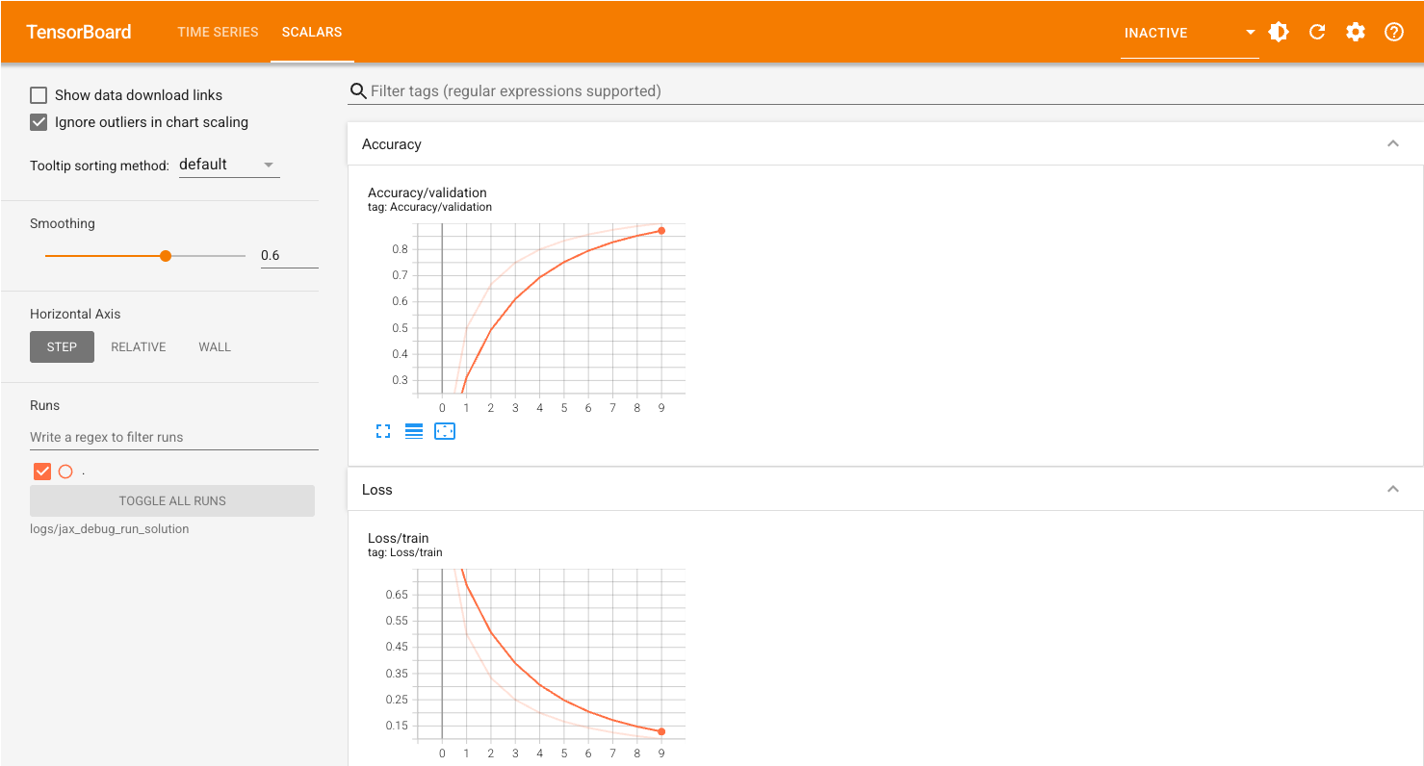
Notes:
This is a screenshot from the debugging code exercise, showing a basic TensorBoard display. TensorBoard has a long list of analysis tools to really dig into your model training performance.

Slide 35
Profiling with XProf, aka JAX Profiler
Notes:
XProf can be used to profile JAX programs. XProf is a great way to acquire and visualize performance traces and profiles of your JAX code, including activity on GPU and TPU. XProf can be run standalone, but it’s also the underlying tool that powers the profiling and trace capturing functionality in TensorBoard.

Slide 36
Installing and Enabling XProf
Installing and enabling XProf in TensorBoard is easy!
XProf includes:
Overview Page, Framework Op Stats, Graph Viewer, HLO Op Stats, Memory Profile, Memory Viewer, HLO Op Profile, Roofline Model, Trace Viewer
!pip install -Uq tensorboard tensorboard_plugin_profile
jax.profiler.start_trace(LOG_DIR) # Capturing trace for xprof
// Some training loop code
jax.profiler.stop_trace()
Notes:
Although XProf can be used outside of TensorBoard we’re going to focus on using it with TensorBoard, since this is a powerful combination. Xprof includes a long list of tools and visualizations for profiling your code.

Slide 37
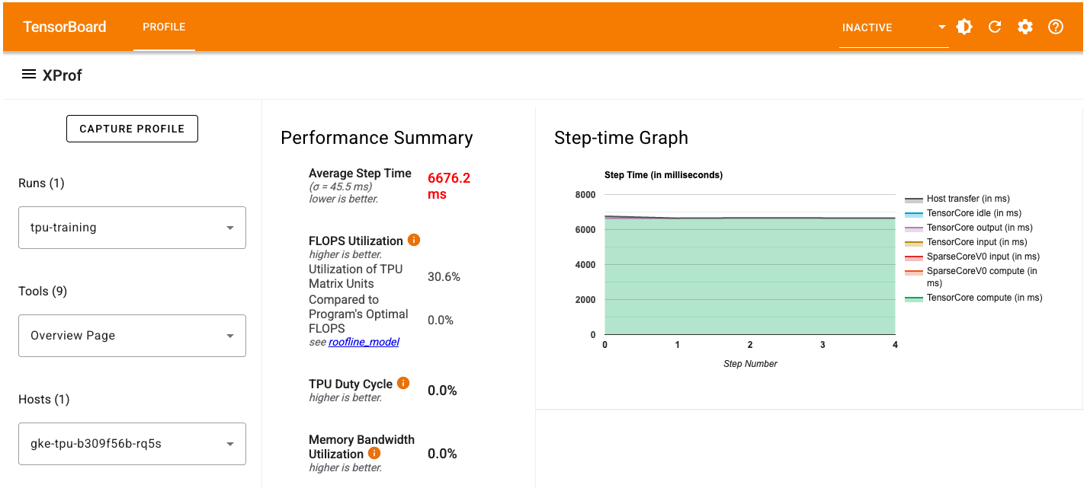
Notes:
Here’s a screenshot of the XProf Framework Op Stats display in TensorBoard.

Slide 38
Digging into your model with Model Explorer
Notes:
Let’s take a quick look at another great tool, Model Explorer.

Slide 39
Exploring the Model with Model Explorer
Model Explorer is a powerful graph visualization tool designed to help you understand and debug your ML models.
Hierarchical Layout
View your model's structure clearly with nested layers that you can expand and collapse as needed.
Metadata Overlays
Gain insights by overlaying metadata (e.g., attributes, inputs/outputs, etc) and custom data (e.g. performance) on nodes.
Powerful Interactive Features
Focus on specific areas with search, navigate graphs smoothly with bookmarks and layer popups, customize node styles with queries, compare graphs side-by-side, and more.
Notes:
Model Explorer is a powerful graph visualization tool designed to help you understand and debug your ML models. It offers a hierarchical layout, allowing you to clearly view your model's structure with nested layers that can be expanded and collapsed. You can also gain insights by overlaying metadata, such as attributes, inputs, and outputs, as well as custom data like performance metrics, directly on the nodes. Model Explorer also comes with powerful interactive features, including search to focus on specific areas, bookmarks and layer popups for smooth navigation, customizable node styles through queries, and the ability to compare graphs side-by-side. There is an example of using Model Explorer in the MNIST coding exercise.

Slide 40
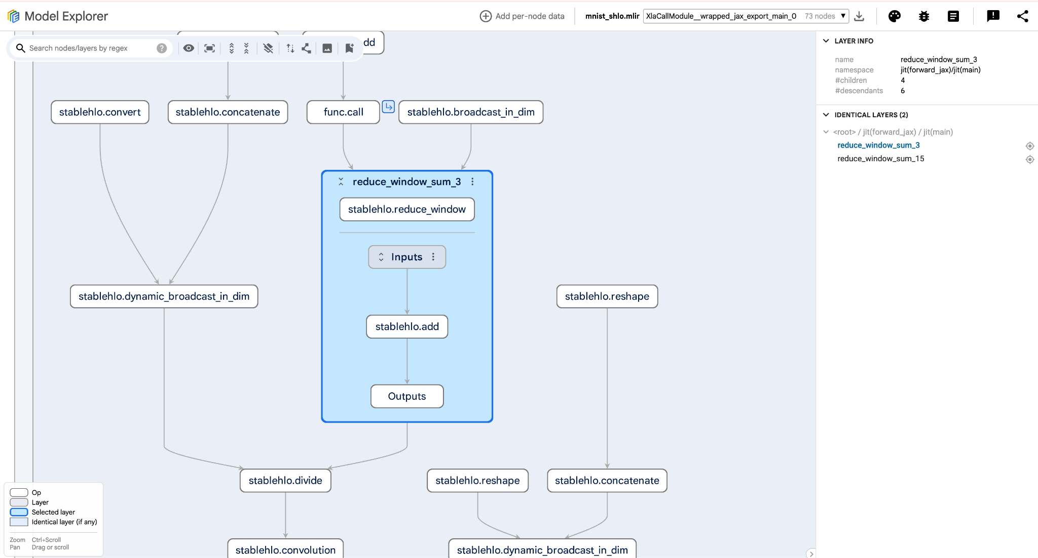
Notes:
Here’s what Model Explorer looks like. You can see the connections between layers and operators, and the ability to dig down into individual layers and operators, scroll around, and really dig into your model. It’s a great tool!

Slide 41
Bridging from PyTorch:
Similarities, Key Differences, & Adaptations
Notes:
Let’s review, and highlight the similarities, key differences, and ways to adapt your PyTorch experience to JAX debugging.

Slide 42
Mapping Your PyTorch Skills to JAX/NNX
Your PyTorch Toolkit:
print() for values
pdb / breakpoint() for interactive steps
Manual NaN/Inf checks
print(model) for structure
TensorBoard
Hooks for intermediate values
Profiler
Notes:
Let's quickly map the concepts. Your familiar PyTorch tools have direct or close counterparts in the JAX world.

Slide 43
Mapping Your PyTorch Skills to JAX/NNX
JAX/Flax NNX Analogues:
Value Inspection: jax.debug.print() (in JIT), print() (if using jax.disable_jit)
Interactive Debugging: jax.debug.breakpoint (in JIT), pdb or IDE (if using jax.disable_jit)
NaN/Inf Checks: chex.assert_tree_all_finite (with chex.chexify)
Structure Inspection: nnx.display(model)
Monitoring: TensorBoard (similar setup/usage)
Assertions: Chex (assert_shape, etc.)
Notes:
Standard print and pdb can be used if you disable JIT. Inside JIT, you use jax.debug.print and jax.debug.breakpoint. For checking NaNs, Chex assertions are a robust option. Instead of printing the model, you use nnx.display. TensorBoard usage is very similar. Chex provides a powerful assertion library.

Slide 44
Key Differences & Necessary Adaptations
JIT is King: The biggest change. Debugging often means choosing:
Use JAX-specific tools (jax.debug.*, Chex + chex.chexify) to work within JIT.
Temporarily disable JIT (jax.disable_jit) to use standard tools, sacrificing performance.
Notes:
While there are similarities, key differences require adaptation. The impact of JIT is paramount – you constantly trade off between using specialized JAX tools within JIT or disabling JIT for standard tools but losing speed.

Slide 45
Key Differences & Necessary Adaptations
Hooks vs. Functional Style: PyTorch uses hooks heavily. JAX/NNX leans towards:
Returning intermediate values explicitly from functions (e.g., using has_aux=True in jax.grad).
Using jax.debug.callback for more complex host interactions.
Transforming functions (like gradient transforms) instead of in-place modification.
Notes:
PyTorch's hook system doesn't have a direct equivalent; JAX encourages more functional approaches like returning intermediate values or transforming functions.

Slide 46
Key Differences & Necessary Adaptations
State Management: NNX uses explicit state. Optimizer updates are now more functional (optimizer.update(model, grads)), making data flow clearer and easier to debug.
Error Messages: JIT compilation can sometimes obscure error origins. Using jax_debug_nans, Chex, or jax.disable_jit helps pinpoint issues more accurately.
Notes:
The way state is managed is more explicit now. For example, the optimizer update is now optimizer.update(model, grads). You explicitly pass the model state in. This functional style makes it much easier to reason about what's happening in your training step, as there are fewer hidden side-effects to track.
Finally, JIT error messages can sometimes be indirect, making tools like Chex, or temporarily disabling JIT, crucial for locating the exact source of a problem.

Slide 47
Recommended Debugging Workflow

Slide 48
A Systematic Approach to JAX/NNX Debugging
Static Checks First:
Use nnx.display() to verify model/optimizer structure and initial state.
Add Chex static assertions (assert_shape, assert_type) liberally.
Manually check input/output shapes outside JIT.
Notes:
So how should you approach debugging? Start with static checks: look at your model with nnx.display, add Chex shape and type assertions.

Slide 49
A Systematic Approach to JAX/NNX Debugging
Runtime Issues within JIT:
NaN/Inf? Use chex.assert_tree_all_finite(model) + @chex.chexify, or enable jax_debug_nans.
Inspect values: Use jax.debug.print.
Interactive step-through: Use jax.debug.breakpoint.
Notes:
If issues arise during runtime inside JIT, your first step for numerical problems should be checking for NaNs or infinities. Because your model is a Pytree, you can directly use chex.assert_tree_all_finite on the entire model object inside a chexified function. This is a huge time-saver. For other issues, use jax.debug.print to inspect values, or jax.debug.breakpoint for interactive debugging.

Slide 50
A Systematic Approach to JAX/NNX Debugging
Complex Issues / Need Standard Tools:
Temporarily use with jax.disable_jit(): around the problematic code.
Use standard print() and pdb/breakpoint(), or IDE debugger.
Notes:
If you're really stuck or the JAX tools aren't cutting it, don't hesitate to temporarily disable JIT to bring in pdb or an IDE debugger.

Slide 51
A Systematic Approach to JAX/NNX Debugging
Performance Issues:
Suspect re-compilation? Use chex.assert_max_traces.
Bottlenecks? Use jax.profiler (+ TensorBoard).
Notes:
For performance, use assert_max_traces and the JAX profiler.

Slide 52
A Systematic Approach to JAX/NNX Debugging
Monitor Continuously:
Integrate TensorBoard early for logging metrics and visualization.
Notes:
And always have TensorBoard running to monitor your training dynamics.

Slide 53
Conclusion
Debugging JAX/NNX requires adapting from PyTorch's eager-first model due to JIT.
Master the JAX toolkit: jax.debug.print, jax.debug.breakpoint.
Know when to use the "escape hatch": jax.disable_jit.
Leverage Flax NNX's inspectability: nnx.display().
Build robustness with Chex assertions (static, value + chex.chexify).
Monitor effectively with TensorBoard.
Choose the right tool for the specific debugging task.
Notes:
So in the end, debugging JAX and Flax NNX effectively involves understanding the implications of JIT compilation and learning the specialized tools JAX provides, like jax.debug.print and jax.debug.breakpoint. Remember jax.disable_jit is your friend for complex issues, at the cost of speed. Flax NNX helps with inspection via nnx.display, and Chex is essential for robust assertions. TensorBoard remains a key part of the workflow. By combining these tools systematically, you can debug your JAX applications efficiently.

Slide 54

Learning Resources
Code Exercises, Quick References, and Slides
https://goo.gle/learning-jax
Notes:
You can learn more about JAX and the entire JAX AI Stack with these coding exercises, quick reference docs, and slides.

Slide 55
Community and Docs
Community:
https://goo.gle/jax-community
Docs
JAX AI Stack: https://jaxstack.ai
JAX: https://jax.dev
Flax NNX: https://flax.readthedocs.io
Notes:
There’s a growing community on Discord for JAX, here’s an invite link, and here are links to the docs for JAX, Flax, and the JAX AI Stack.

